Slide 1
Motion Planning
Jacob Knispel
Jay Shankar
Alec Tiefenthal

Slide 2
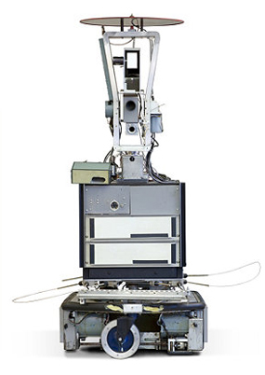
Shakey the Robot
Built by SRI’s AI center in 1966
“First electronic person”
Led to breakthroughs in image analysis, computer vision, and pathfinding
Notes:
Bullet 1: Stanford Research Institute
Bullet 2: Quote by Life magazine inserted mostly for a laugh
Bullet 3: Nils Nilsson developed A* with his colleagues as an improvement on Djikstra’s, which doe

Slide 3
Notes:
Demonstration of why choosing the closest waypoint every time (“Greedy” search) is not always the best strategy – orange dots are waypoints, the blue dot is the starting point

Slide 4
A* Algorithm
Avoids expanding paths that are quickly expensive
Uses application-based heuristic to estimate future cost
Notes:
Top-right – unweighted, searching for path
Bottom-left – Heuristic valuing nodes closer to the destination makes for faster computation but less optimal paths
h(n) can never overestimate the actual path cost (assumes no obstacles, basically)

Slide 5
D* Algorithm
Dynamic A* search

Slide 6
D* Lite Algorithm
Is at least as efficient as D* and is substantially shorter

Slide 7
Our Implementation

